Slide 1

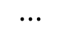

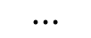

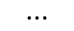

Property Prediction
Attention Module
$$⋯$$
Attention Module
Bi-GRU
$$⋯$$
Softmax
Character Embedding
$$a_{3}^{i}$$
$$⋯$$
q
$$k_{3}^{i}$$
$$⋯$$
Key
Projection
Key
Projection
Key
Projection
Key
Projection
Key
Projection
Key
Projection
$$⋯$$
Learnable
Query
Position Embedding
Character Embedding
O=C4C=CC3=C(C1=C(C(O)=O)C=CC=C1)C2=C(C=C(O)C=C2)OC3=C4

Slide 2
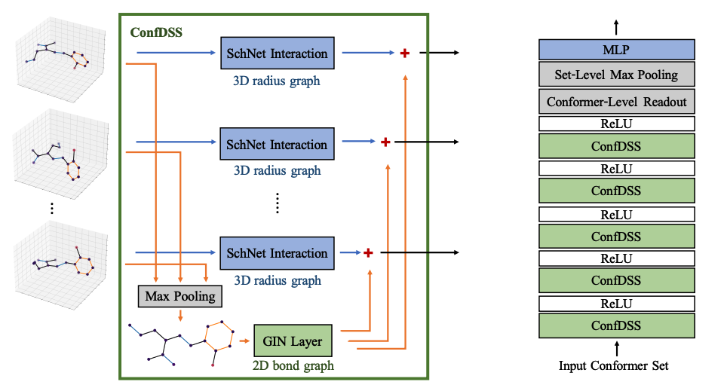
Notes:
AI4Science workshop

Slide 3
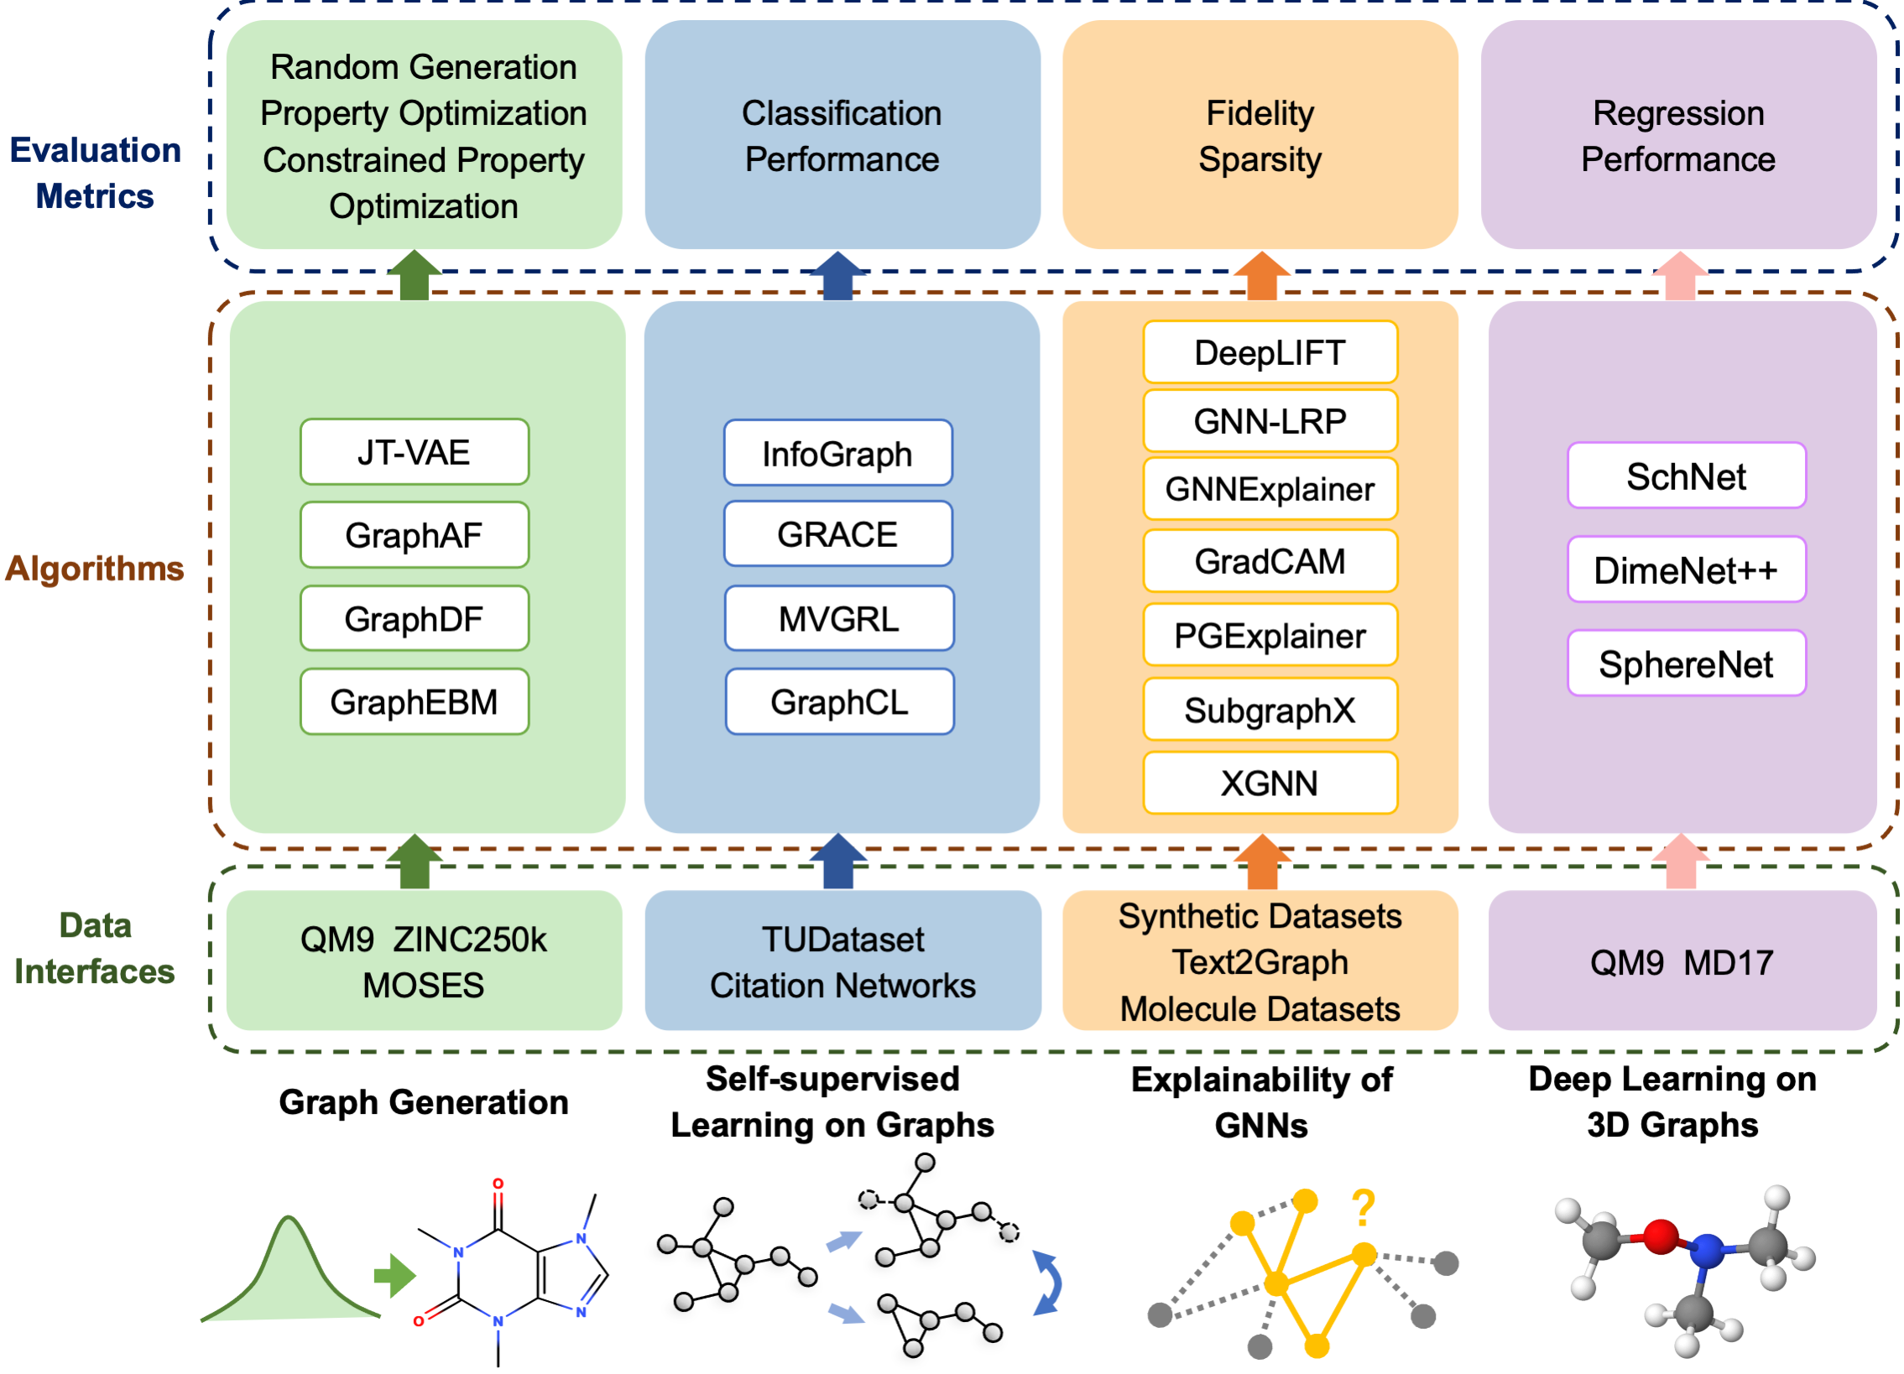

Slide 4
Notes:
SphereNet, ICLR 2022

Slide 6
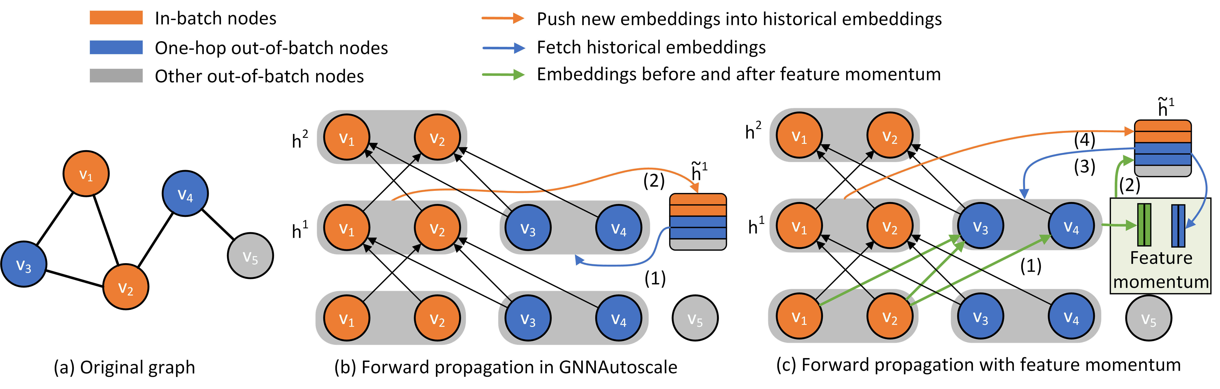
Notes:
GraphFM, ICML 2022

Slide 7
Notes:
ComENet, NeurIPS 2023

Slide 8
Datasets:
GOOD-HIV
GOOD-PCBA
GOOD-ZINC
GOOD-CMNIST
GOOD-Motif
GOOD-Cora
GOOD-Arxiv
GOOD-CBAS
Covariate shift split
Concept shift split
Notes:
GOOD, NeurIPS benchmark 2023

Slide 9
Notes:
ProNet, ICLR 2023

Slide 10
Notes:
LEFTNet

Slide 11
Notes:
LatentDiff

Slide 12
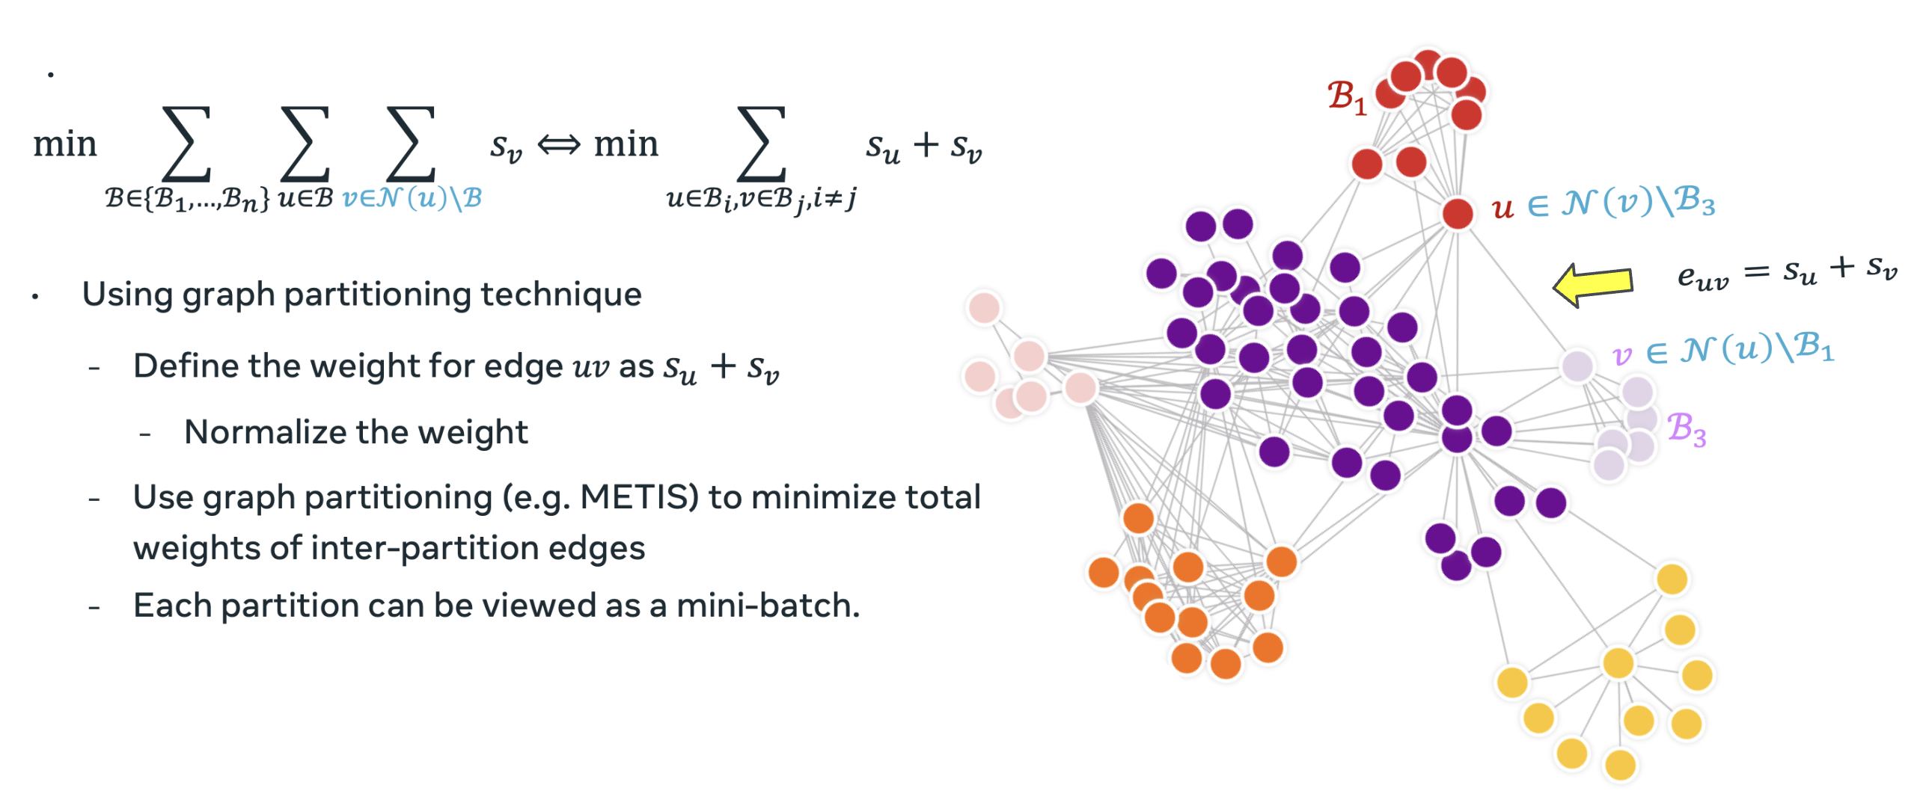

Slide 13
